Slide 1
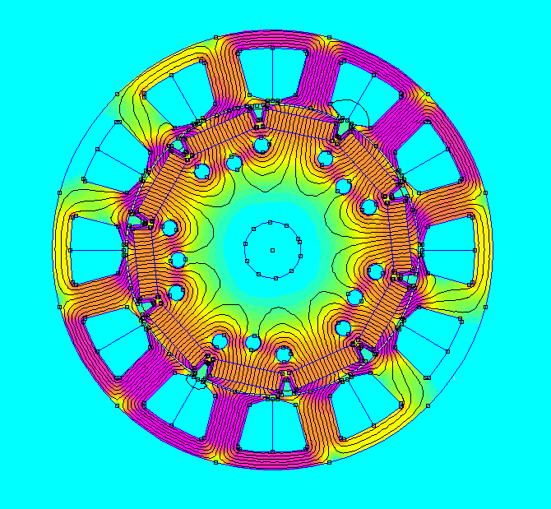
MOTOR
DESIGN
By
Arun Ramana

Slide 2
What are we going to learn today?
How to design and draw a motor from the geometry specified by Motor Wiz?
How to simulate the design we have drawn?
Demonstration Of the Motor Design Tool developed at MOTORZ.

Slide 3
Familiarize With Tools
FEMM - Finite Element Method Magnetics:
Is a powerful software tool used for simulating and analyzing electromagnetic fields and devices. (It can also be used to simulate Electrostatics and Current Flow)
CAD & DXF:
CAD (Computer-Aided Design) is a technology that allows engineers and designers to create detailed digital models of objects and systems.
DXF (Drawing Exchange Format) is a file format commonly used in CAD software to facilitate the exchange design data between different programs and platforms.

Slide 4
Familiarize With Terminology:
Rotor: The rotating part of the motor that contains the magnets or windings.
Stator: The stationary part of the motor that houses the windings to create the magnetic field.
Air gap: The space between the rotor and stator where the magnetic interaction occurs.
Shaft: The central axis that connects and supports the rotor and enables rotational movement.
Winding: The arrangement of coils in the stator or rotor that carries electric current.
Stack Length: refers to the axial dimension or height of the stator and rotor core laminations, indicating the length of the magnetic path within the motor.

Slide 5
Familiarize With Terminology:
Slot: An opening in the motor where the winding is placed.
Tooth: The part of the stator core that helps shape and guide the magnetic flux path.
Poles: Regions of the stator or rotor where magnetic fields are concentrated (Permanent Magnets In our case).
Pole Arc: The angular span of the rotor pole, which influences motor performance. In 180° of the rotor, what is the angle covered by the poles?
Topology: The specific arrangement and configuration of components, such as stator and rotor structures, winding types, and magnetic circuit layouts, in an electric motor design.
Magnetic flux: is the measure of the total magnetic field passing through a given surface, representing the number of magnetic field lines per unit area perpendicular to the direction of the field. (Radial & Axial)

Slide 6
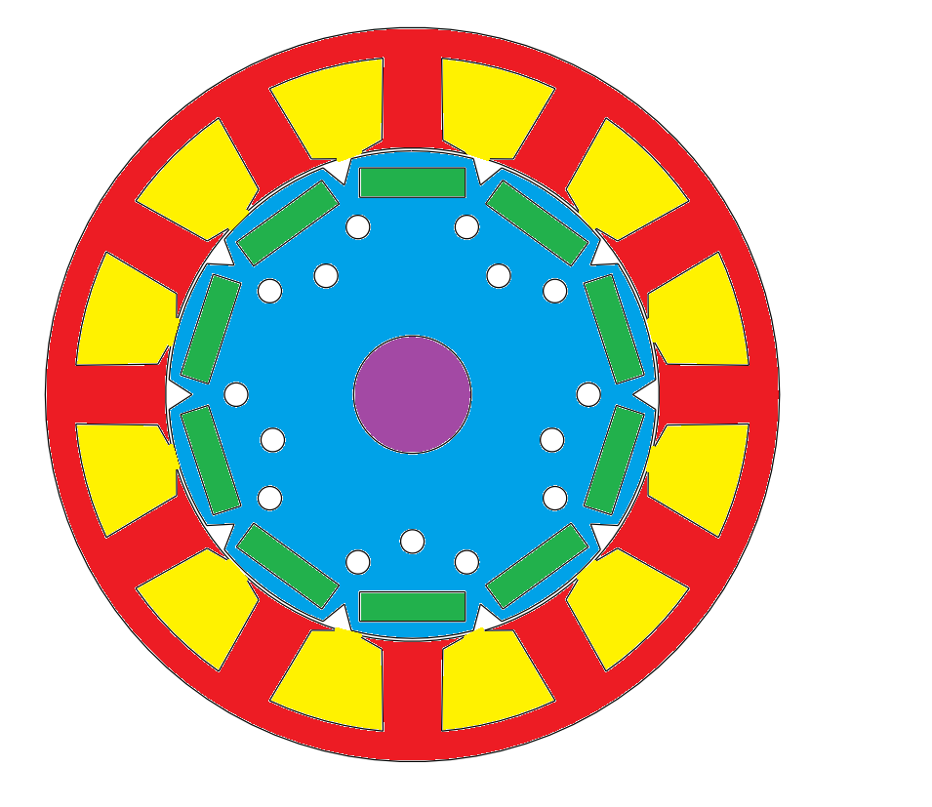
IPMSM - Radial Flux Geometry
LEGEND
Shaft
Rotor
Air Gap
Stator
Slot
Tooth (in Slot)
Pole
6

Slide 7
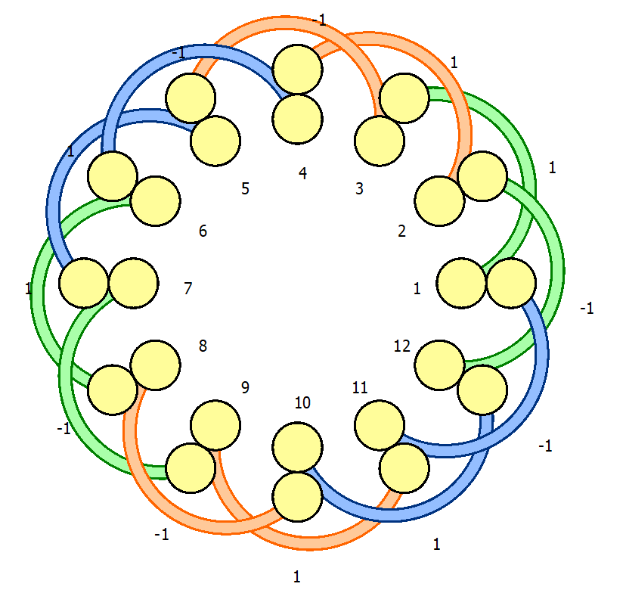
MOTOR - WINDING DIAGRAM
LEGEND
U - Phase
V - Phase
W - Phase

Slide 8
What are we Designing ?
The motor that we are designing has the following specification:
Topology:
IPMSM Radial Flux ( Interior Permanent Magnet Synchronous Motor): electric motor with permanent magnets embedded in the rotor and magnetic flux flows perpendicular to the axis.
Slot Pole Combination:
12 slots and 10 poles
Winding:
Three Phase Double Layer Concentrated Winding.
Materials:
1. Magnet: N42 RE (Rare Earth)
2. Steel: M250-35A
3. Wire: Copper 20 SWG

Slide 9
What Information Do We Have? (Input)
From Motor Wiz:
Rotor Outer Diameter (Rotor OD)
Tooth thickness (t)
Slot OD
Slot depth
Yoke thickness
Stator OD
Rotor ID
Dm (mean slot dia)
Stack Length
Number Of Slots (12)
Number Of Poles (10)
Air Gap (0.5mm)
Pole Length
Pole Width
Assumptions:
Pole Arc: 150°
Slot Opening: 3mm
Bridge Thickness: 1mm
Shaft Diameter: 20mm
Tooth Tip Angle: 30°

Slide 10
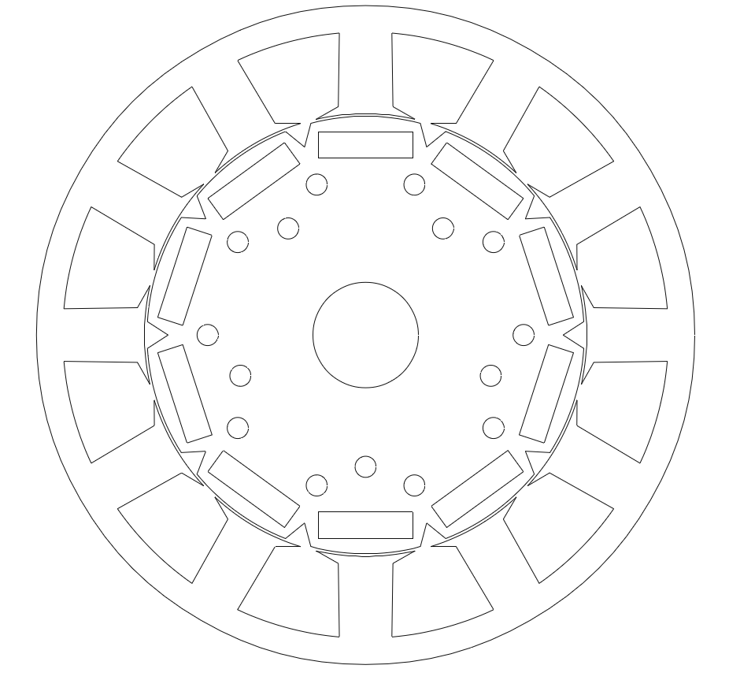
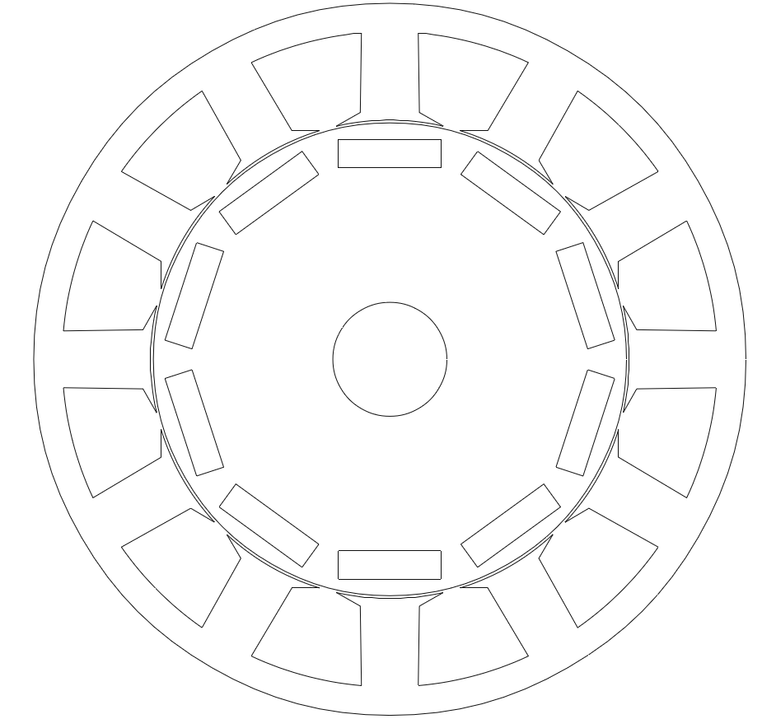
What Should Be the Output?

Slide 11
DXF Entities
Points: Specified by coordinates (x,y)
Lines: Specified by two points ((x1,y1),(x2,y2))
Circles: Specified by centre point and the radius ((xo,yo), r)
Arcs: Specified by centre point, radius and an angle ((xo,yo), r, angle)

Slide 12
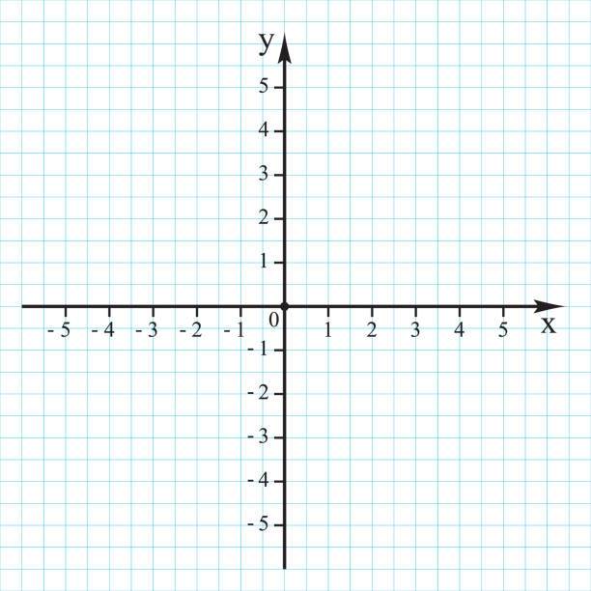
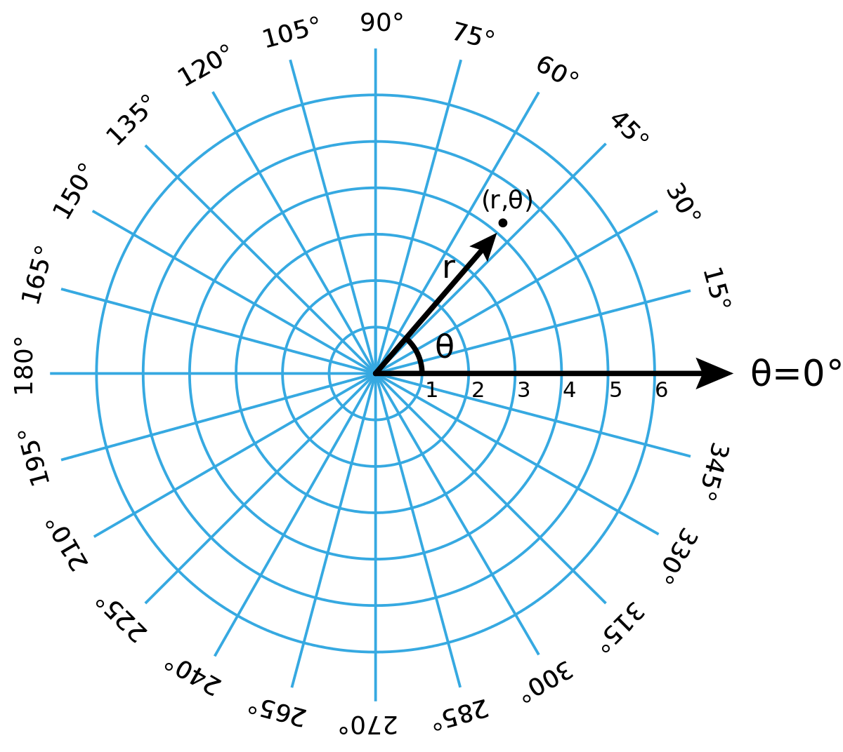
Coordinate Systems
Cartesian Coordinates (x,y)
Polar Coordinates (r,𝚹)

Slide 13
Why should we consider Polar Coordinates?
To exploit the circular symmetry of the IPMSM Radial Motor’s Topology.
The geometrical inputs, we are going to use are already given in terms of radius and angles.

Slide 14
Basic Formulae & Conversions:
Sinθ = opposite
hypotenuse
Cosθ = adjacent
hypotenuse
Tanθ = opposite
adjacent
S = Rθ
circumference = 2𝝅R
Polar to Cartesian:
x = r × Cos θ
y = r × Sin θ
wrt horizontal line
Cartesian to Polar:
r = √(x^2+y^2)
θ = Tan inverse(y/x)
Degrees to Radians:
Deg = (180×radians)/ 𝝅
Radians to Degrees:
Radians = (𝝅×degrees)/180

Slide 15
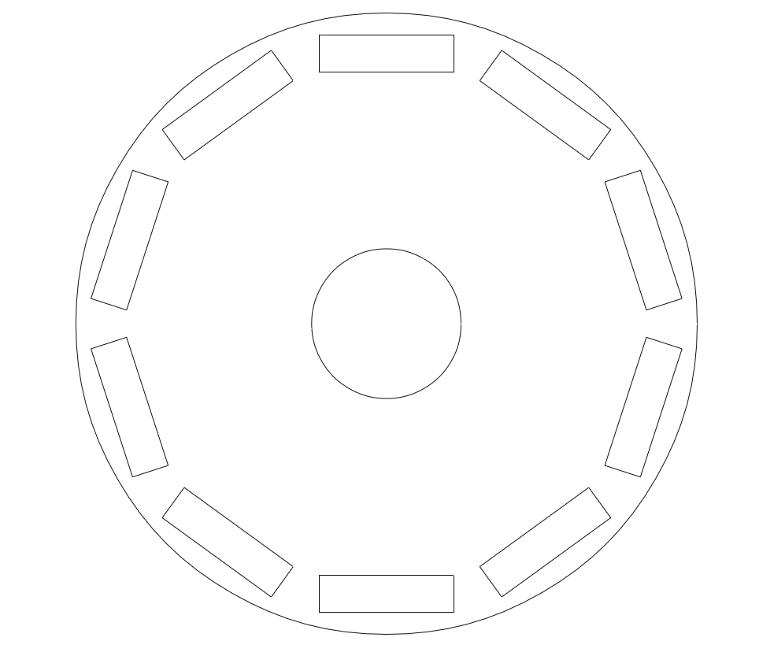
Drawing The Rotor

Slide 16
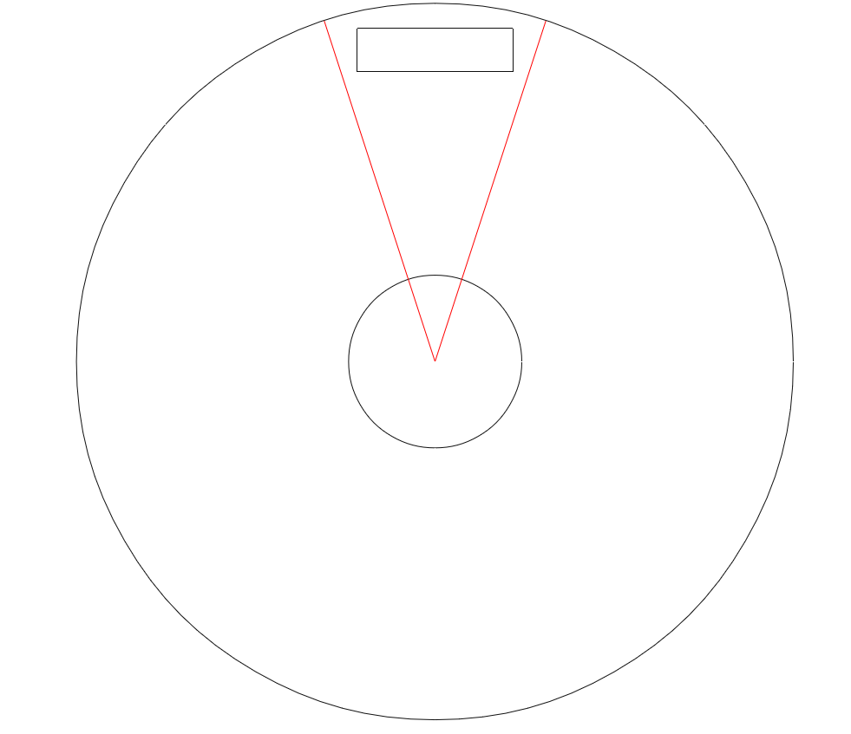
Rotor Segment

Slide 17

Draw Rotor And Shaft
Draw Circle with and origin at (0,0) and radius:
Shaft: Shaft_radius
Rotor: Rotor_outer_radius

Slide 18
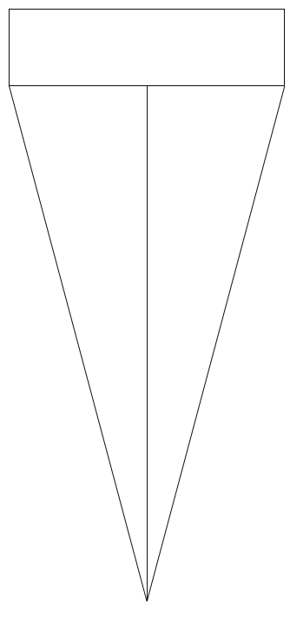
Drawing Pole
To Find (x1,y1) and (x2,y2):
Pole Length
reference_angle = 0 (increment by 36 deg)
pole_angle = (pole_arc*2)/no_poles
θ = pole_angle/2
θ1 = reference_angle +θ
θ2 = reference_angle - θ
R1 = pole_length/(sin(θ)*2)
R2 = pole_length/(sin(θ)*2)
x1 = R1*sin(θ1)
y1 = R1*cos(θ1)
x2 = R2*sin(θ2)
y2 = R2*cos(θ2)
pole_distance = R1*cos(θ)
Pole Width
x1,y1
x2,y2
Pole Distance
R1
R2
θ1
θ2
Pole angle
0,0

Slide 19
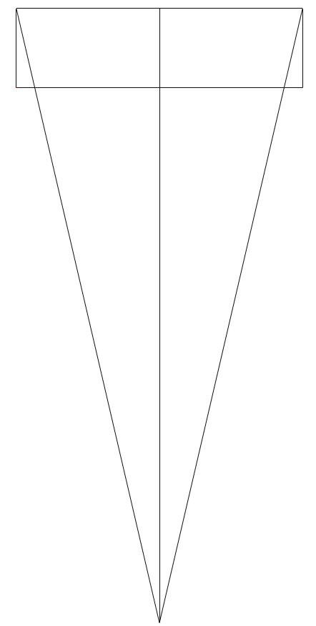
Drawing Pole
To Find (x3,y3) and (x4,y4):
x4,y4
Pole Length
x3,y3
reference_angle = 0 (increment by 36 deg)
h = pole_distance+pole_width
θ = taninv(pole_length/(2*h))
θ3 = reference_angle -θ
θ4 = reference_angle + θ
R3 = pole_length/(sin(θ)*2)
R4 = pole_length/(sin(θ)*2)
x3 = R3*sin(θ3)
y3 = R3*cos(θ3)
x4 = R4*sin(θ4)
y4 = R4*cos(θ4)
Pole Width
x1,y1
x2,y2
Pole Distance
R4
R3
θ4
θ3
0,0

Slide 20

Drawing The Stator

Slide 21
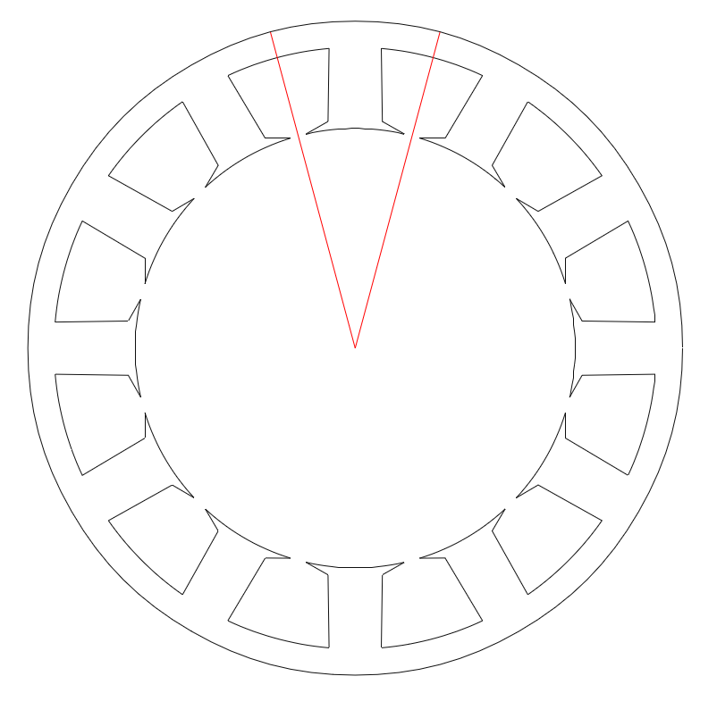
Stator Segment

Slide 22
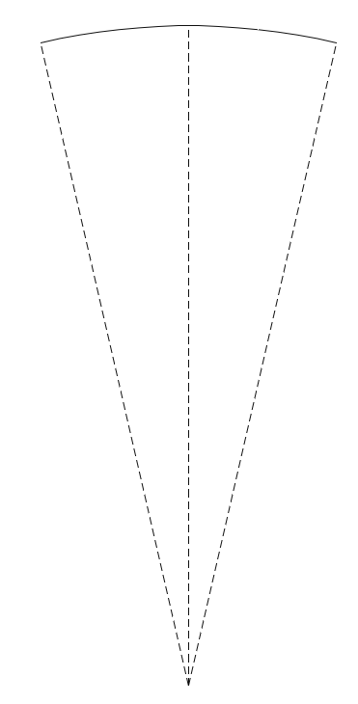
Tooth Arc
To Find (x1,y1) and (x2,y2):
Tooth Arc
reference_angle =0
R = Stator Inner Radius
stator_opening_total = 2𝝅R- slot_opening*no_slots
tooth_arc_s = stator_opening_total/no_slots
tooth_arc_theta = (tooth_arc_s*2)/stator_id
θ = tooth_arc_theta*180/𝝅/2
θ1 = reference_angle + θ
θ2 = reference_angle - θ
Draw arc using (R,θ1,θ2 and (0,0))
x1 = R*sin(θ1)
y1 = R*cos(θ1)
x2 = R*sin(θ2)
y2 = R*cos(θ2)
x1,y1
x2,y2
reference angle
R
θ1
θ2
0,0

Slide 23
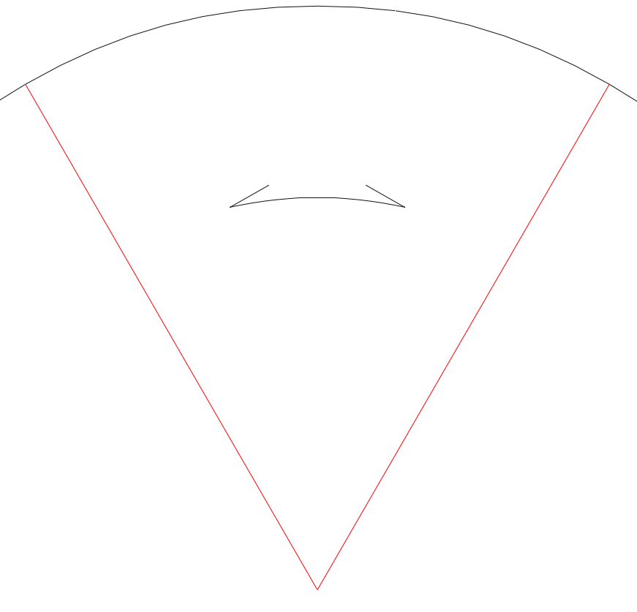
Draw Tooth Tip

Slide 24
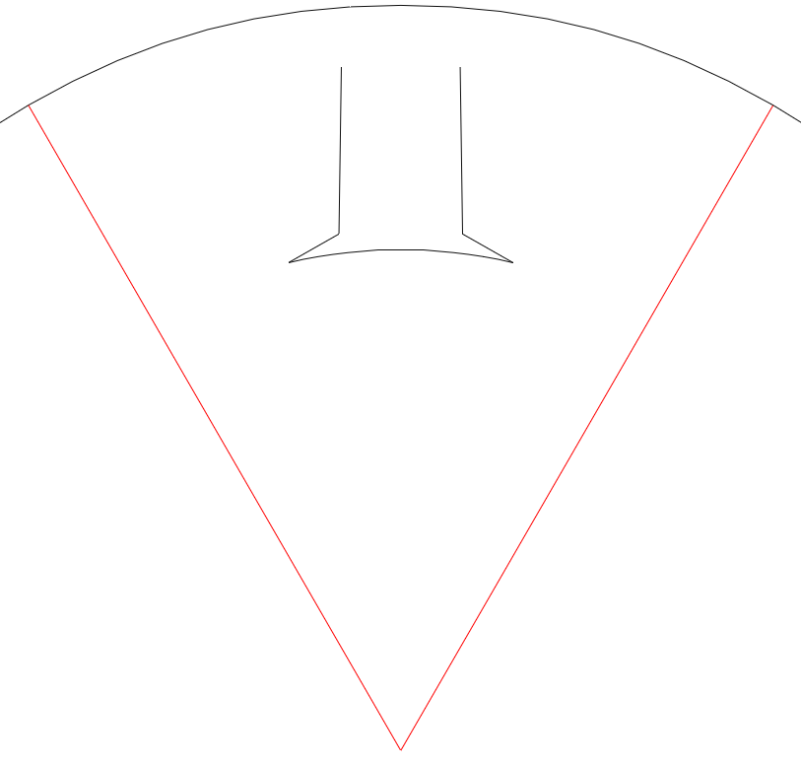
Draw Toothbase

Slide 25

Connect All the Teeth

Slide 26
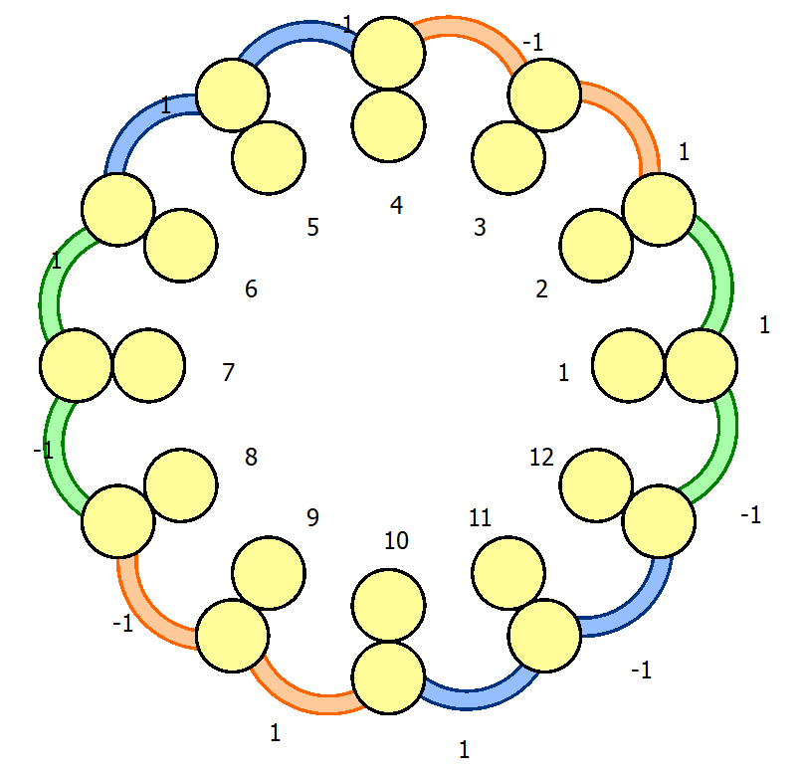
Winding Diagram
Legend
U - Phase
V - Phase
W - Phase

Slide 27
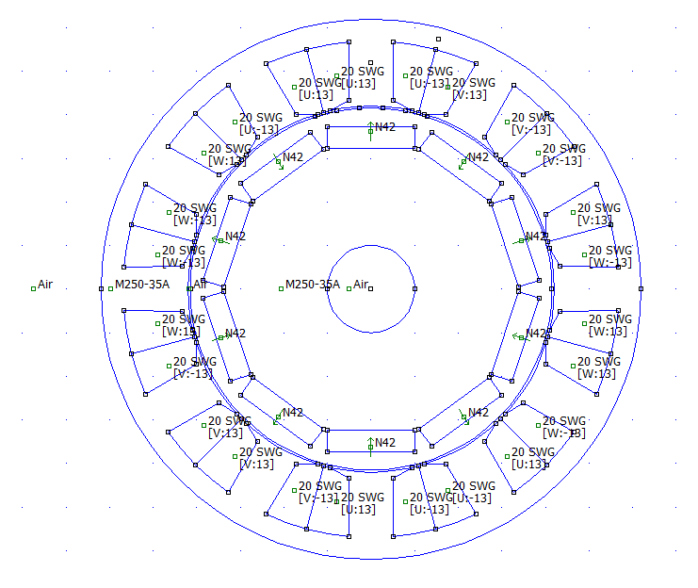
Simulating in FEMM: Adding Material And Winding

Slide 28
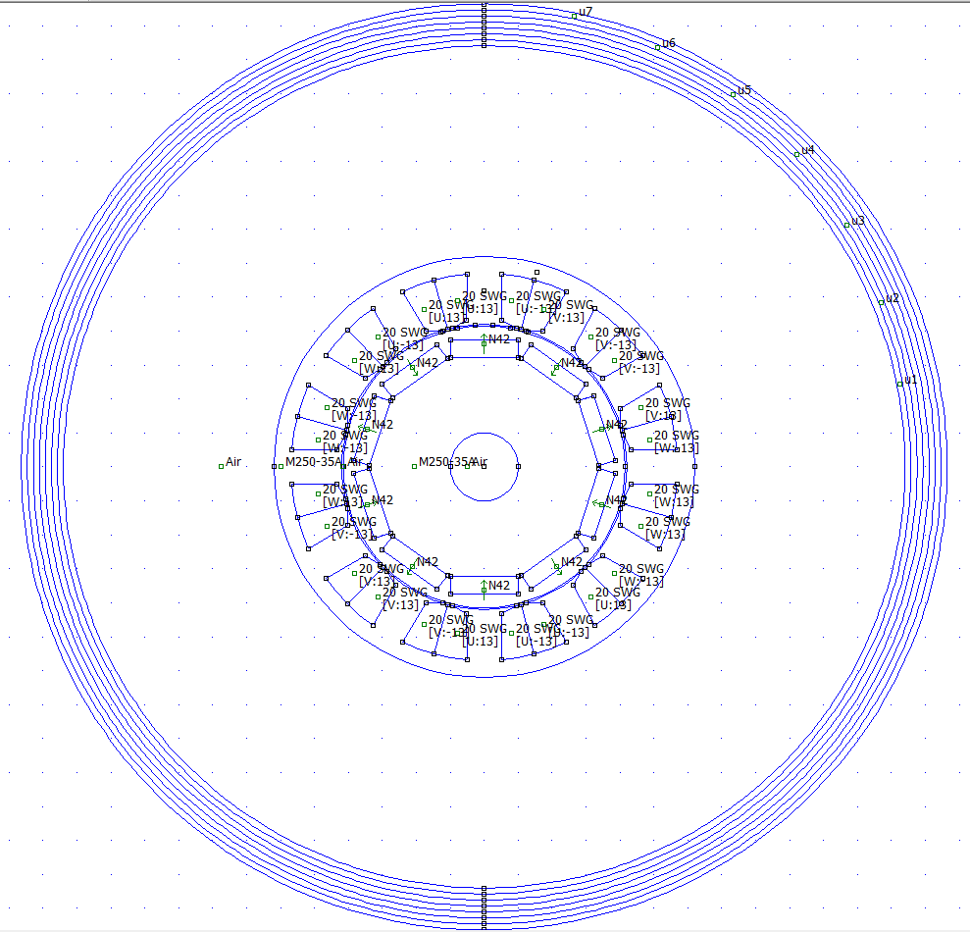
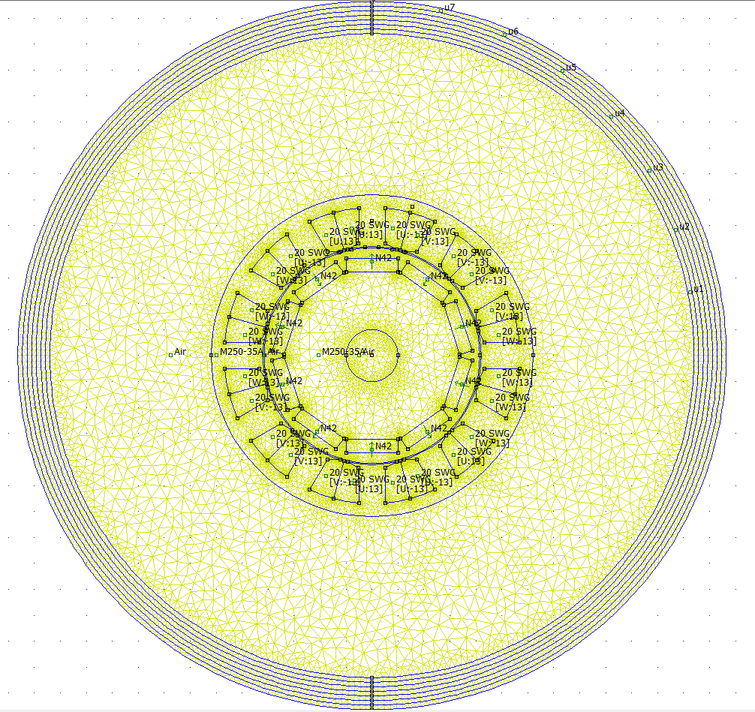
Simulation Results: Boundary & Meshing
Dirichlet Boundary
Meshing

Slide 29
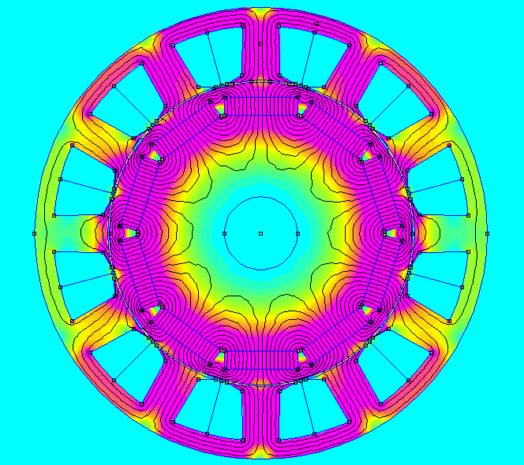
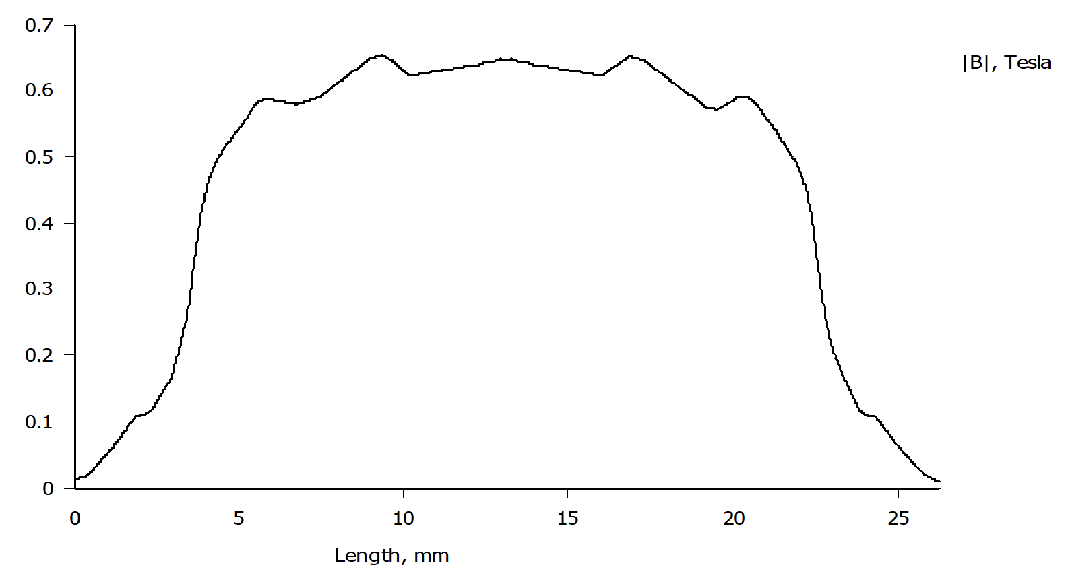
Simulation Results
Magnetic Flux Density Plot
Air Gap Flux Plot

Slide 30
THANK YOU

